Slide 1
DLH Consumption Architecture
Target State
2/16/2026

Slide 2
Overview

Slide 3
Why a Consumption Architecture
Organizational demand for data has diversified and intensified - analytics, operational services, streaming, and AI now coexist.
Modern data consumers expect ready-to-use, supported data - quality, documentation, clear ownership, and predictable access; data discovery cannot be a scavenger hunt.
A single EDW “gold” is no longer sufficient - different consumers require different shapes, latencies, and delivery mechanisms.
A consumption architecture enables multiple governed “golds” - APIs, streaming data, AI/RAG access, curated datasets, and EDW/datamarts — all sourced from enterprise CDMs.

Slide 4
What is a Consumption Architecture
The modern data platform emphasizes egress from Enterprise CDMs to multiple consumables — data is delivered, not just stored.
The architectural approach becomes consumer-centric rather than source-centric — shifting from a traditional Left-to-Right (source-driven) model to a Right-to-Left (consumer-driven) strategy.
Consumption architecture defines the services, contracts, and patterns that transform governed CDMs into fit-for-purpose data products.
Enterprise Data Platform
DATA SOURCES INGRESS TO CDMs
DATA PRODUCTS EGRESS FROM CDMs
Ingest Architecture
CDMs
Consumption Architecture
Notes:
where previous Lakehouse and EDW architectures focused on Ingress of data through the medallion stores to the single gold

Slide 5

How to Implement a Consumption Architecture
Implement consumption through Data Products — governed, deployable units of data delivery
Align Data Products to Enterprise Standard CDMs to ensure consistency and reuse
Separate Core Data Products (CDM-aligned, reusable) from Use Case Data Products (purpose-built compositions)
Apply Consumption Rules & Configurable Functions consistently across products (quality, filtering, aggregation, security)
Deliver fit-for-purpose Consumables (datamarts, extracts, APIs, AI-ready datasets)
Source Systems
Enterprise Standard CDMs
CDM Aligned Core Data Products
Use Case Data Product
Use Case
Source
Core
CDMs
Core
Use Case
Source
Source
Core

Slide 6
Target-State Lakehouse Consumption Architecture:
Consumption Architecture
Navitus’s consumption architecture should support:
Clear ownership
Alignment with CDMs
Abstraction from CDMs
Governance and the Consistent Application of Consumption Rules
Versioning
SLAs
Discoverability & Reusability
Self Service for Consumers
Support for AI Integration
The data product construct naturally bundles those into a deployable unit
CDM
Data Products
Consumables
Claims
Core
Use Case
Finance Datamart
Eligibility
Eligibility
Datamart Dim
Claims Extract
Plan & Benefit
Plan
Claim
Formulary
Benefit
Member
Member API
Utilization Mgmt
Util Mgmt
Configurable Functions
AI MCP
Data Store
Consumption Rules

Slide 7
AI Components

Slide 8
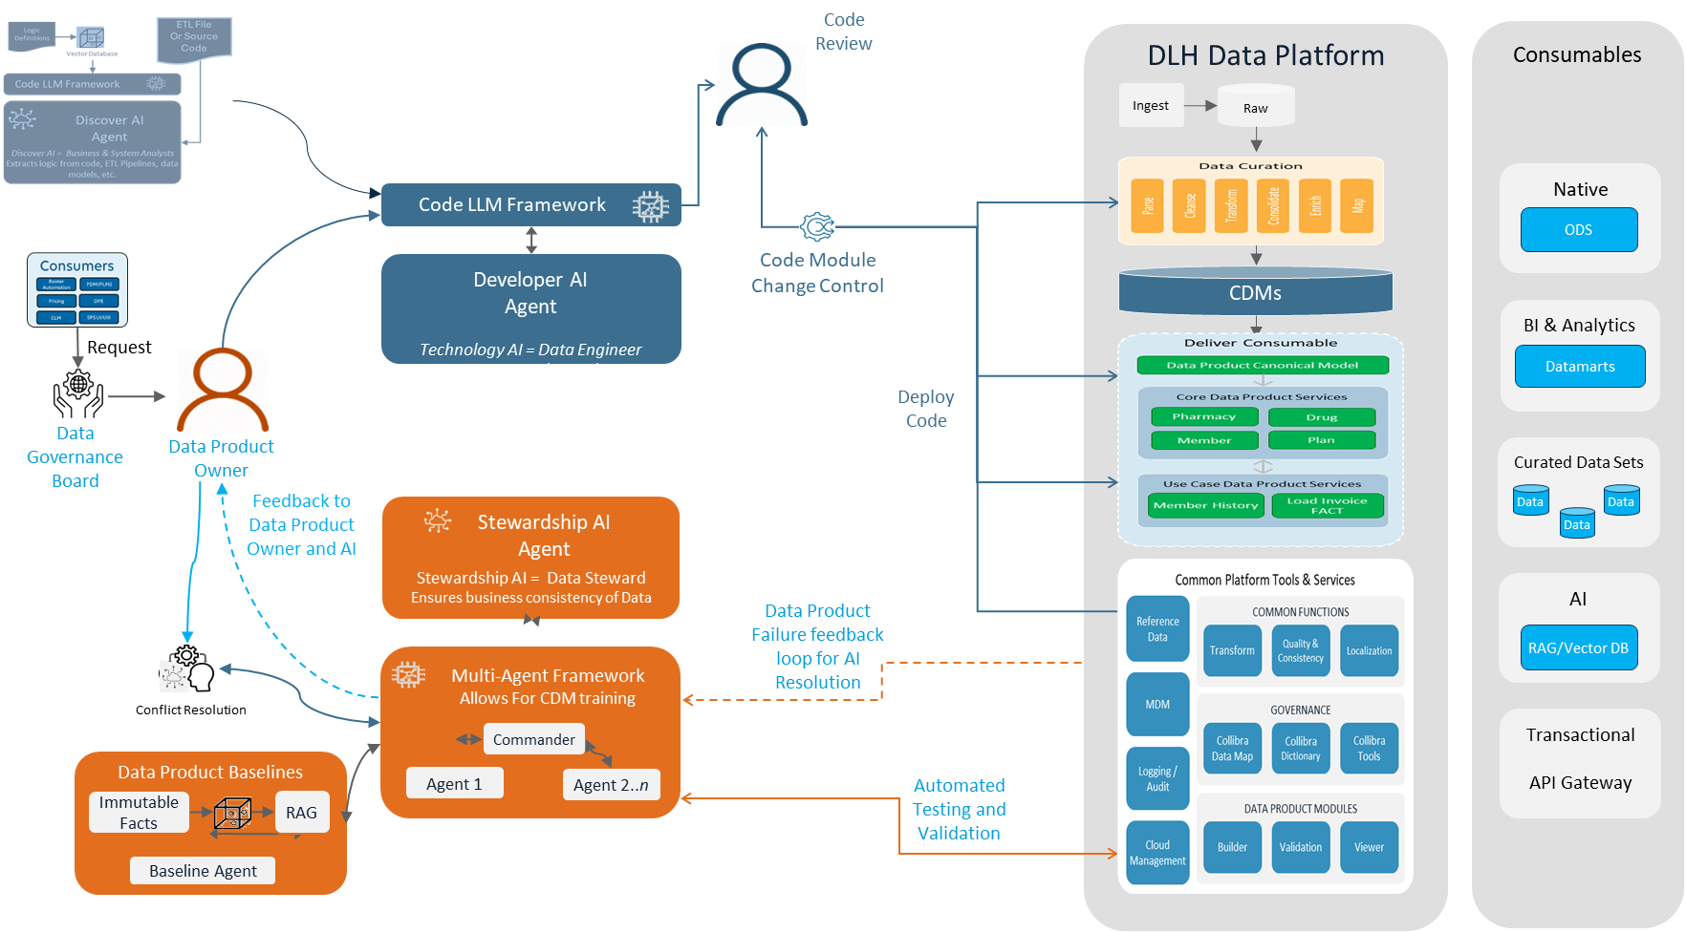
DLH Platform – AI Augmentation
Key Benefits
Quick & Low-Cost Deployment – Using AI new sources can be evaluated, deployed and tested in hours
Reduced Human Error – Using automation to do jobs that humans find repetitive or time consuming
Self-Healing Pipelines and Integration – Failures and errors drive a feedback look that self-correct modules
Data Catalog, Lineage, and other Governance – Humans, Developer AI and Data Steward AI cooperate to ensure governance practices and policies are supported
Automated Change Control – As AI generates code, it follows a change control process to deploy new modules and updates
Human Oversite – AI will identify many possible actions to take; the organization determines where human approval or action is required
Open Integration – Reduces need to migrate from existing tools all at once or at all
1
6
7
5
2
6
2
3
4
Notes:
Ray D’Onofrio
Can we use Agentic AI to address problems that organizations are facing?
Increased demand for data labeling, cataloging and lineage
Faster data integration (Time to market)
Reducing human error in cataloging and data stewardship
Can we manage risks associated with AI in this process?
Hallucination
Oversight
By designing a data platform that leverages Agentic workflows we have done that and more

Slide 9
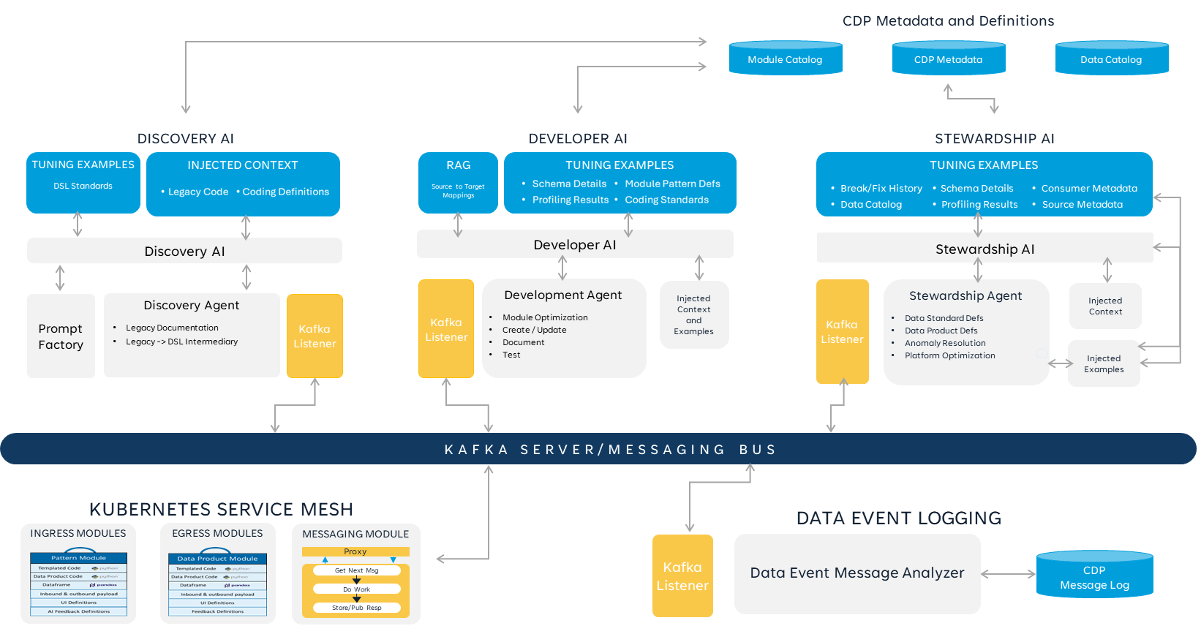

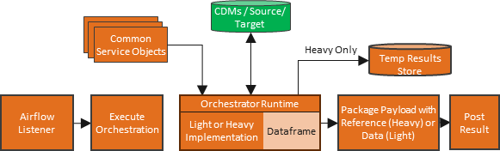
AI Integration
Platform
Platform Metadata
Human Oversite
Listener
Listener
Listener
Administrator
AI Dashboard
SERVICE / MESSAGE BUS
Change Approvals
Listener
Platform Message Log

Slide 10
Technical Architecture

Slide 11
DLH Platform Logical Architecture Overview
NAVITUS DLH DATA PLATFORM
PRODUCERS
CONSUMERS
Data Curation
Canonical Data Models (CDM)
Consumables
Producer
APIs
Parse
Cleanse
Transform
Consolidate
Enrich
Map
Native
Plan & Benefit
Data
Canonical Model 1
Canonical Model n
Lakehouse
ODS
SME / Stewards
Ingest
BI & Analytics
Claim
Data
Datamarts
BI
Development
Request DP Canonical
Return DP Canonical
Common Platform Tools & Services
Deliver Consumable
Reference Data
Reference Data
COMMON FUNCTIONS
Data Product Canonical Model
Curated Data Sets
Third
Party Data
Transform
Quality & Consistency
Localization
Data
Data
Data Science
Core Data Product Services
Data
Master
Data
MDM
Pharmacy
Drug
AI
GOVERNANCE
AI
Government Data
Collibra Data Map
Collibra Dictionary
Collibra Tools
Member
Plan
RAG/Vector DB
Logging / Audit
Tools Data
DATA PRODUCT MODULES
Use Case Data Product Services
Transactional
API Gateway
Lumicera
Data
Cloud
Management
Builder
Validation
Viewer
Member History
Load Invoice FACT
Business
Services
Conical Model n

Slide 12
The Technology That Makes It Works
Core Architecture
A single execution fabric delivers both ingress pipelines and egress data products
Orchestrations are DSL-defined and parameterized, composed from reusable services and aligned to Enterprise CDMs
Control Plane
DAG is the first-class execution contract (versioned composition of steps/services)
Message bus is the coordination backbone: dispatch, status, routing, and event-based integration
All executions post transactions/events to the bus. Audit Service persists immutable run history and lineage
Data Plane
Orchestrator Runtime executes the DAG by consuming anonymous/composable transform functions/services
Runtime maintains the in-flight dataset/state (dataframe) for performance
Light execution: Glue / Pandas; Heavy execution: Glue / Spark
Large outputs materialized to S3/Iceberg and returned to consumers by reference (bus remains “thin”)
End-User Orchestration
Guided self-service tool to assemble Use Case Data Products from Core Data Product services + common transforms
Produces validated DSL/DAG artifacts. The validator executes test runs and verifies results before publishing
AI-enabled assistance can recommend choices/optimizations, but the tool operates without requiring AI
Key Benefits
Reusable building blocks avoid custom pipelines for each new consumable
Auditable by design via bus transactions + persisted DAG/run history
Scales efficiently with Light/Heavy execution lanes and reference-based outputs
Extensible: new services, transforms, and listeners integrate via the bus without rewiring orchestrations
Evolves as a platform — not a collection of custom workflows
Core Architecture
Core Architecture
A single execution fabric delivers both ingress pipelines and egress data products
Orchestrations are DSL-defined and parameterized, composed from reusable services and aligned to Enterprise CDMs
Data Plane
Orchestrator Runtime sidecar executes the DAG by consuming anonymous/composable transform functions
Runtime maintains the in-flight dataset/state (dataframe) for performance
Light execution: ECS / Glue Python Shell; Heavy execution: Spark
Large outputs materialized to S3/Iceberg and returned to consumers by reference (bus remains “thin”)
End-User Orchestration
Guided self-service tool to assemble Use Case Data Products from Core Data Product services + common transforms
Produces validated DSL/DAG artifacts; validator executes test runs and verifies results before publish
AI-enabled assistance can recommend choices/optimizations, but tool operates without requiring AI
Key Benefits
Reusable building blocks avoid custom pipelines for each new consumable
Auditable by design via bus transactions + persisted DAG/run history
Scales efficiently with Light/Heavy execution lanes and reference-based outputs
Extensible: new services, transforms, and listeners integrate via the bus without rewiring orchestrations
Evolves as a platform — not a collection of custom workflows
A single execution fabric delivers both ingress pipelines and egress data products
Orchestrations are DSL-defined and parameterized, composed from reusable services and aligned to Enterprise CDMs
Data Plane
Orchestrator Runtime sidecar executes the DAG by consuming anonymous/composable transform functions
Runtime maintains the in-flight dataset/state (dataframe) for performance
Light execution: ECS / Glue Python Shell; Heavy execution: Spark
Large outputs materialized to S3/Iceberg and returned to consumers by reference (bus remains “thin”)
End-User Orchestration
Guided self-service tool to assemble Use Case Data Products from Core Data Product services + common transforms
Produces validated DSL/DAG artifacts; validator executes test runs and verifies results before publish
AI-enabled assistance can recommend choices/optimizations, but tool operates without requiring AI
Key Benefits
Reusable building blocks avoid custom pipelines for each new consumable
Auditable by design via bus transactions + persisted DAG/run history
Scales efficiently with Light/Heavy execution lanes and reference-based outputs
Extensible: new services, transforms, and listeners integrate via the bus without rewiring orchestrations
Evolves as a platform — not a collection of custom workflows

Slide 13

AI Ready, Lakehouse Conceptual Architecture Benefits and Features
Benefits and Refinements
Defined Orchestration, eliminates hard to debug event processing
Allows for end-to-end in-memory processing using the Orchestration Runtime’s dataframe
Collibra rule execution is more efficient, distributed out to each Orchestration
No need to use pydeequ, all rules can reside in Collibra utilizing functional programming concepts
Collibra becomes a true rules library
Simplifies overall architecture with shared ingest and consumption architecture
AI ready architecture
Supports Self Service creation of Use Case Data Products
User clickable use case data product definition process
Store Orchestrion Metadata
Data Product / Pipeline Definition and Validation UI
Determine Execution Type(s)
Identify Required
Common Services
Identify Required Customized Service
Parameterize
Service Calls in Orchestration
Create Orchestration Package(s)
Deploy Orchestration
Design
Under the hood
CDMs / Source/ Target
Common Service Objects
Heavy Only
Temp Results Store
Heavy Only Payload
HTTP Proxy Use Case Data Product Call
Airflow
Listener
Execute Orchestration
Orchestrator Runtime
Package Payload with Reference (Heavy) or Data (Light)
Post Result
Execution
Light or Heavy Implementation
Dataframe
Consumable or Pipeline Request for Use Case Data Product
Post Use Case Request
Message or Event Bus
Result Listener
Consumer
Reference
Data Listener
Transaction Log / Audit Trail
AI Listener
Collibra Listener

Slide 14
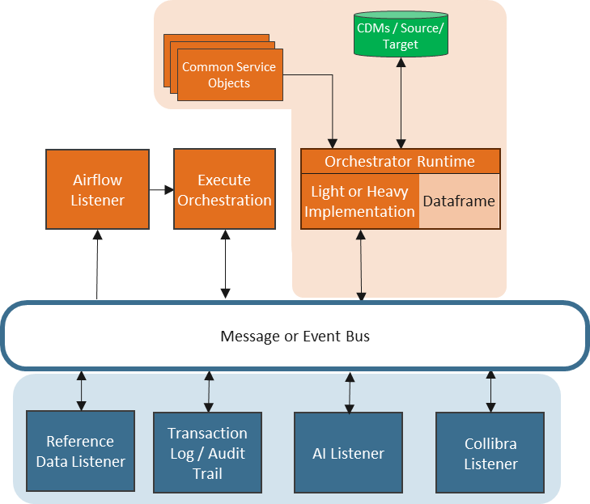
Lakehouse Function Execution Model
Functional Execution Model
Each data process is just a sequence of reusable steps applied in order.
Functions are pure business logic primitives (filter, join, enrich, validate, aggregate)
Execution logic is engine-agnostic; routing changes compute, not composition
Deterministic execution: identical inputs + configuration → identical outputs
In-Memory Runtime Optimization
Dataset is loaded once into the RuntimeFrame and transformed end-to-end
Eliminates repeated I/O between services
Persistence occurs only when
Bus remains “thin” — references, not payloads
Event-Driven Coordination Backbone
Every step emits structured execution events
Bus decouples orchestration from:
Audit & lineage capture
Data quality enforcement
AI optimization & routing
Reference data enrichment
New capabilities subscribe to events without modifying pipelines
Extensibility
Message Bus allows for continued growth of platform
High value, future platform capabilities can be seamlessly integrated int the Orchestrations including:
Reference Data and MDM capabilities
AI for Data Steward implementation
Extending audit capabilities, just drop a message on the bus
Enterprise Data Quality via Collibra is fully integrated, not a bolt on:
Retrieves Parameterized DQ Rules from Collibra DQ&O
Executes in-memory within RuntimeFrame stack
Publishes results back to Collibra
Converts Collibra into a true centralized rules library
Strengths: governance + runtime enforcement
Eliminates: siloed validation layers

Slide 15
Organizational Support

Slide 16
How to Organizationally Support – What We Do
Chief Data Officer │ ├── 1. Enterprise Data Products (20) │ │ │ ├── Enterprise Data Analysis │ │ │ ├── Canonical Data Modeling │ │ │ ├── Off-Platform Data │ │ │ └── Data Product Design – Ingress / Egress │ ├── 2. Enterprise Data Governance (6) │ │
│ ├── Collibra Data Quality & Collibra Dictionary │ │ │ ├── Policy & Compliance Oversight │ │ │ └── Integration Engineering │ ├── 3. AI Data Engineering (10) │ │ │ ├── AI Enablement │ │ │ └── Data Product & Pipeline Configuration │ ├── 4. Platform Engineering (14) │ │ │ ├── Infrastructure as Code │ │ │ ├── Core Platform Components │ │ │ ├── Platform Tools │ │ │ ├── Ingress & Egress Platform Services │ │ │ └── Shared Platform Services │ └── 5. Delivery & Assurance (12) │ ├── Architecture │ ├── Product & Project Management │ ├── Testing / QA │ └── Operations & Support
Enterprise Data Products (EDP)
Purpose Owns enterprise data semantics and lifecycle from business alignment through canonical realization and consumable design. Ensures CDMs accurately reflect operational systems and business meaning.
Primary Customers
Business domain leaders
Analytics organization
Enterprise AI organization
Application/product system owners
Downstream data consumers
Enterprise Data Governance (EDG)
Purpose Ensures enterprise data integrity, policy enforcement, stewardship, lineage transparency, and regulatory compliance across deterministic and AI-enabled workflows.
Primary Customers
Risk & Compliance
Business data owners
CDO leadership
Enterprise AI (trusted metadata and lineage)
AI Data Engineering (DE)
Purpose Operationalizes AI inside the data lifecycle. Builds and governs AI tooling for mapping, transformation automation, stewardship acceleration, and pipeline configuration.
This is AI applied to data systems — not business process AI.
Primary Customers
Enterprise Data Products
Platform Engineering
Governance
Enterprise AI (indirectly via governed semantic exposure)
Platform Engineering (PE)
Purpose Builds and operates the DLH technical foundation and shared ingress/egress services. Ensures infrastructure stability, security, and scalability.
Primary Customers
All internal CDO teams
Enterprise Security
Enterprise AI (runtime integration)
Delivery & Assurance (D&A)
Purpose Owns execution discipline, architecture coherence, roadmap coordination, testing rigor, and production stability across the organization.
Ensures work is delivered predictably, tested thoroughly, and supported operationally.
Primary Customers
CDO leadership
Business stakeholders
All internal engineering teams
Analytics & Enterprise AI (release reliability)

Slide 17
How to Organizationally Support – Who We Are
Chief Data Officer │ ├── 1. Enterprise Data Products (20) │ │ │ ├── Enterprise Data Analysis │ │ │ ├── Canonical Data Modeling │ │ │ ├── Off-Platform Data │ │ │ └── Data Product Design – Ingress / Egress │ ├── 2. Enterprise Data Governance (6) │ │
│ ├── Collibra Data Quality & Collibra Dictionary │ │ │ ├── Policy & Compliance Oversight │ │ │ └── Integration Engineering │ ├── 3. AI Data Engineering (10) │ │ │ ├── AI Enablement │ │ │ └── Data Product & Pipeline Configuration │ ├── 4. Platform Engineering (14) │ │ │ ├── Infrastructure as Code │ │ │ ├── Core Platform Components │ │ │ ├── Platform Tools │ │ │ ├── Ingress & Egress Platform Services │ │ │ └── Shared Platform Services │ └── 5. Delivery & Assurance (12) │ ├── Architecture │ ├── Product & Project Management │ ├── Testing / QA │ └── Operations & Support
Enterprise Data Products (20) – Department Head
Enterprise Data Analysis
9 Enterprise Data Analysts
Data Product Design – Ingress / Egress
1 Data Product Engineer
2 Data Product Technical Analysts
2 SQL Developers
Off-Platform Data
1 SQL Developer
2 Data Analysts
Canonical Data Modeling
1 SQL Developer
1 Data Engineer
Enterprise Data Governance (6) – Department Head
Collibra Data Quality & Collibra Dictionary
2 Collibra Administrators
1 Governance / Data Management Specialist
Policy & Compliance Oversight
1 Data Governance Manager
Integration Engineering
1 Integration Engineer
AI Data Engineering (10) – Department Head
AI Enablement
2 Software Engineers
1 Data AI Tools Engineer
1 Dev AI Tools Engineer
1 Steward AI Platform Integration Engineer
Data Product & Pipeline Configuration
2 Ingress Configuration Specialists
2 Egress Configuration Specialists
Platform Engineering (14) – Department Head
Infrastructure
2 IaC Engineers
Core Platform Components
2 Core Platform Engineers
Platform Tools
3 Platform Tools Engineers
Ingress & Egress Platform Services
4 Platform Service Engineers
Shared Platform Services
2 Service Engineers
Delivery & Assurance (12) – Department Head
Architecture
1 Enterprise Data Products Architect
1 Enterprise Data Governance Architect
1 AI Data Engineering Architect
1 Platform Engineering Architect
1 Floating / Cross-Domain Architect
Product & Project Management
1 Product Owner
2 Project Managers
Testing / QA
1 Test Planner / Test Manager
2 Test Engineers
Operations & Support
2 Troubleshooting / Level 1 Support
1 Monitoring & Audit

Slide 18
Lakehouse Consumption Architecture Summary
Standardized execution eliminates pipeline duplication
Business logic written once – runtime selects execution context
Governance, DQ, and audit embedded by design
Event-driven extensibility enables continuous innovation
AI readiness is architectural — not aspirational

Slide 19
Appendix 1 Data Products

Slide 20


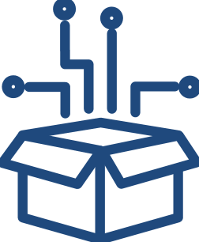
Data Products Technical
What is a Data Product?
They empower users to extract actionable insights, automate processes, optimize performance, and create new opportunities based on data-driven intelligence.
Plays a crucial role in leveraging the value of data assets and enabling data-driven decision-making, innovation, and competitiveness in various industries and domains.
Focuses on managing and enforcing policies, regulations, and standards related to data privacy, security, and compliance.
Provides capabilities for data classification, access control, auditing, and monitoring to ensure data integrity and regulatory compliance.

Slide 21

Data Products: Core vs Use Case specific
Source Systems
Core Data Products
Use Cases
Core Data Product
Is a foundational data-driven solution that forms the backbone of an organization's data strategy.
Is very aligned with data domains
Involves unified data management capabilities that serve multiple use cases and stakeholders across the organization.
Provides a business-friendly view of a data domain, managed by a Data Product Owner, backed by a roadmap aligned with prioritized business capabilities
Typically represented in third-normal-form (3NF) as an Operational Data Store (ODS)

Slide 22
Data Products: Core vs Use Case specific
Source Systems
Core Data Products
Use Case Data Products
Use Cases
Use Case Data Product
Is a data-driven solution developed to address specific business problems or fulfill specific user needs.
Often built on top of core data products but are more specialized and use case-oriented
Tailored to serve a specific use case or set of use cases within an organization, focusing on delivering targeted insights, functionalities, or outcomes to meet business process or user group requirements
Typically represented as a denormalized dimensional model, optimizing runtime performance for heavy workloads
ML Models are utilized to address predictive and prescriptive use cases
Designed to address specific business objectives or improve specific aspects of operations

Slide 23
Appendix 2 DLH Platform – Architectural Influences

Slide 24
Why a Consumption Architecture
Grounding Tenet:
To standardize how the enterprise consumes data — with governance, reuse, auditability, and scalability built in.
Enterprise-Controlled Consumption
Single, governed DLH consumption layer — no direct extracts
CDM-based Data Products as the authoritative enterprise interface
Controlled schema evolution with versioning and stability guarantees
Stable interfaces that protect downstream consumers
Delivers: Consistency, change protection, and architectural discipline
Reuse by Design
Reusable filtering, aggregation, enrichment, and reconciliation services
Data quality and governance logic implemented once, reused everywhere
Cross-domain alignment through canonical data models
Eliminates one-off pipelines and duplicated transformation logic
Delivers: Lower cost, faster onboarding, reduced technical debt
Audit-Ready by Default
Built-in lineage, quality validation, and execution status tracking
Centralized monitoring and traceability
Accountable SLAs (freshness, latency, completeness)
Compliance and AI oversight embedded into runtime
Delivers: Regulatory confidence and operational transparency
Scalable, Resilient Delivery
Supports simple and complex use cases without custom builds
Protects upstream systems from ad-hoc demand
Uniformly supports analytics, operational APIs, and AI workloads
Designed for enterprise IT transformation readiness
Delivers: Enterprise scale without architectural chaos
A consumption architecture ensures Navitus scales with control — not complexity

Slide 25
From Ingestion-Driven to Outcome-Driven Architecture Right-to-Left Thinking: Designing from the Product Back
Traditional Model (Left → Right) | Data Product Model (Right → Left) | What This Changes
Start with available source data | Start with required business outcome | Consumption drives architecture
Build pipelines around systems | Define governed product interface | Products define contracts
Hydrate CDMs based on ingestion | Hydrate CDMs based on product demand | Intentional data modeling
Implementation driven by feeds | Implementation driven by product contract | Pipelines serve products
Architecture is driven by what data exists. | Architecture is driven by how the data will be used
Core Shift
From To
What data do we have? What data product must we deliver?
Data Products align platform investment to business outcomes — not source systems

Slide 26
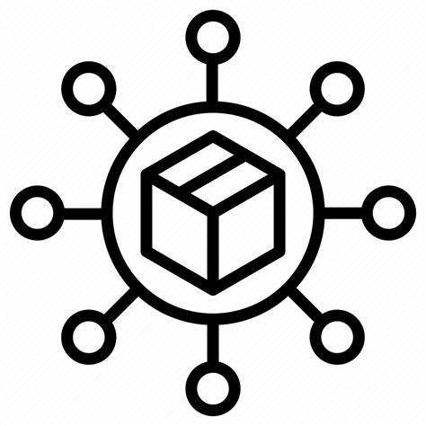

Target-State Lakehouse Consumption Architecture: CDM + Pattern Modules → Data Products → Consumables
DATA SOURCES INGRESS TO CANONICAL STANDARD
DATA PRODUCTS EGRESS FROM CANONICAL MODEL
DATA SOURCE SERVICES*
ENTERPRISE STANDARD
CORE DATA PRODUCTS
Orchestrator – Overall ingress orchestration
Filter - Select/exclude records based on criteria
Router - Direct data flow based on content
Sequencer - Manage dependencies (Data Sync)
CDMs
CORE INGRESS SERVICES*
USE CASE DATA PRODUCTS
CONSUMABLE PATTERNS
Reader - Source system interaction (Connectors)
Parser - Format conversion and structure parsing
Cleanser - Data cleansing and standardization
Mapper - Schema transformation (Translation pattern)
Enricher - Add derived fields and reference data
Aggregator - Perform calculations (SUM, COUNT, AVG)
Integrator - Combine data from multiple sources
Consolidator - Merge duplicate/similar records
Validator - Enforce quality standards
Writer - Output to target systems
A consolidated model aligned with each Core Data Product Canonical model
Pattern Templates
ODS/Native
Warehouse
Curated Data Sets
Vector / Rag
Transactional / APIs
BUSINESS RULE SERVICES
COMMON DATA PRODUCT
Cleansing
Data Quality
Translation
Enrichment
Aggregation
Filtering
Integration
Consolidation
DATA GOVERNANCE & DATA MANAGEMENT
Data Synchronization
Data Quality Standards
Data Cleansing Standards
Lineage
Logging & Journaling
Snapshot / Archive
Reference Data
Master Data

Slide 27
Appendix 3 DLH Platform – Technical Architecture Overview

Slide 28
Data Lakehouse “Big Block” Diagram
DATA MANAGEMENT SERVICES
DATA PRODUCT SERVICES
PLATFORM APPLICATIONS
Core Data Products
Use Case Data Products
Common Data Products
Builder UI
Module Validate/Execute
Catalog UI
Quality & Cleansing
DATA PATTERN SERVICES
Wrapper Services
Dashboards / Analytics
Change Control
AI Steward UI
Reference Data
Ingress Patterns
Egress Patterns
AI SERVICES
Ingestion
Curation
Business Rules
Consumption
Third Party Solutions
Master Data
Development
Stewardship
Add/Change Module
DQ Analysis
Platform Data Services
New Source
Error Analysis
Data Products
Data Patterns
Data Management
AI
Integration
Application
New Consumer
Profiler
HYPERSCALE SERVICES
Infrastructure
Compute
Data
Integration
AI PROVIDERS
Security
DevOps
Monitoring
Alerting
Identity Management
Serverless
Data Storage
Relational, Lake
NoSQL
Consumable Data
Secure, Curated
Mastered
Streaming Data
IoT
Third-Party
Synchronous
ML/AI
LLM
Vector Services
Containerization
Asynchronous
Other Models
Graph Services

Slide 29
AI Ready, Lakehouse Conceptual Architecture Benefits and Features
Config-Driven Design & Execution
Eliminates custom pipeline sprawl as the routing, logic selection, and service invocation are determined by centrally managed configurations, defined by Data Product SMEs — not custom code
Single Governed Entry & Routing
All requests
Enter through a central entry point via a DLH Consumption API
Routed by a governed orchestration layer
Optimized Processing Path
Policy-based light vs heavy execution routing
Simple requests are executed immediately
Complex or long‑running processes scale out through containerized microservices.
Reusable Services
Standard services (quality, filtering, aggregation, enrichment) are composable and invoked consistently by design
Consistent Results Delivery
All outputs are
Written to governed consumption folders
Standardized with built-in lineage, status, and audit visibility
User clickable use case data product definition process
Store Orchestrion Metadata
Data Product / Pipeline Definition and Validation UI
Determine Execution Type(s)
Identify Required
Common Services
Identify Required Customized Service
Parameterize
Service Calls in Orchestration
Create Orchestration Package(s)
Deploy Orchestration
Design
Under the hood
CDMs / Source/ Target
Common Service Objects
Heavy Only
Temp Results Store
Heavy Only Payload
HTTP Proxy Use Case Data Product Call
Airflow
Listener
Execute Orchestration
Orchestrator Runtime
Package Payload with Reference (Heavy) or Data (Light)
Post Result
Execution
Light or Heavy Implementation
Dataframe
Consumable or Pipeline Request for Use Case Data Product
Post Use Case Request
Message or Event Bus
Result Listener
Consumer
Reference
Data Listener
Transaction Log / Audit Trail
AI Listener
Collibra Listener

Slide 30
AI Ready, Lakehouse Conceptual Architecture Ingress to CDM and Egress from CDM
Design
User clickable use case data product process
Data consumer SME configures their own Use Case Data Product from available:
Core Data Products
Reuse of Existing Use Case Data Products
Available Common Services
Generates configuration (Orchestration Script)
Assembles into Use Case DP Service package (which is deployed on to Message/Event Bus)
Execution
Under the hood
Use Case Data Product Requests are received on Message/Event Bus
Event listeners invoke the previously deployed Use Case DP Service
Gets source data
Invokes all configured function
Packages results and stores in S3
Posts status and URI for result set on Message/Event Bus
User clickable use case data product definition process
Store Orchestrion Metadata
Design
Data Product / Pipeline Definition and Validation
Config Table
Determine Execution Type(s)
Identify Required
Common Services
Identify Required Customized Service
Parameterize
Service Calls in Orchestration
Create Orchestration Package(s)
Deploy Orchestration
Under the hood
CDMs / Source/ Target
Common Service Objects
Heavy Only
Temp Results Store
Heavy Only Payload
HTTP Proxy Use Case Data Product Call
Airflow
Listener
Execute Orchestration
Orchestrator Runtime
Package Payload with Reference (Heavy) or Data (Light)
Post Result
Execution
Light or Heavy Implementation
Dataframe
Consumable or Pipeline Request for Use Case Data Product
Post Use Case Request
Message or Event Bus
Result Listener
Consumer
Reference
Data Listener
Transaction Log / Audit Trail
AI Listener
Collibra Listener

Slide 31
Lakehouse Functional Execution Model
Engine-Agnostic Execution: One Pattern, Any Runtime
Governed Orchestration API request triggers governed orchestration, which composes reusable services from configuration
Data Loaded Once RuntimeFrame loads data by defined shape (CDM / Datamart / Export)
Composable service implementations Transformers apply business logic once, supporting
Light – Returns result dataset
Heavy - Returns pointer to service instance ID, which will be used to:
Check status
Retrieve data via S3 URL
Supports multiple data shapes (Flat for analytics & external systems / Nested for APIs & AI)
Event Bus publishes execution events for enrichment and governance
Enables virtualized CDMs without duplicating pipelines
Supports nested and chained orchestration
Enterprise Data Quality
Integrated, not bolted on
Retrieves Parameterized DQ Rules from Collibra DQ&O
Executes in-memory within RuntimeFrame stack
Publishes results back to Collibra
Converts Collibra into a true centralized rules library
Strengths: governance + runtime enforcement
Eliminates: siloed validation layers
CDMs / Source/ Target
Common Service Objects
Heavy Only Payload
Airflow
Listener
Execute Orchestration
Orchestrator Runtime
Post Result
Light or Heavy Implementation
Dataframe
Consumable or Pipeline Request for Use Case Data Product
Message or Event Bus
Result Listener
Consumer
Reference
Data Listener
Transaction Log / Audit Trail
AI Listener
Collibra Listener

Slide 32
Appendix 4 DLH Platform – Data Product Definition

Slide 33

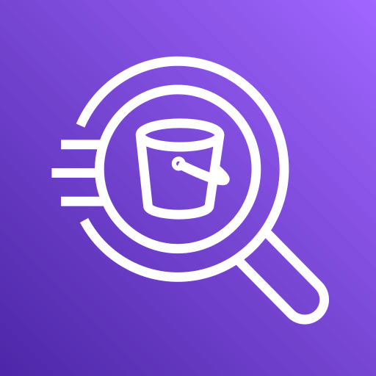
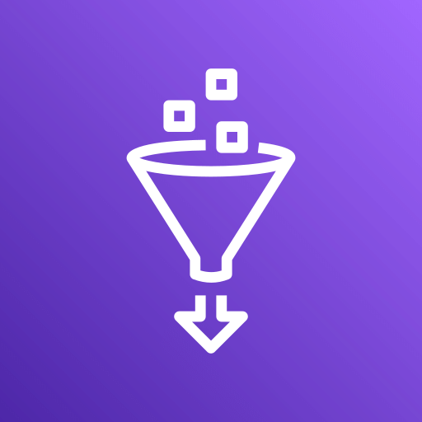
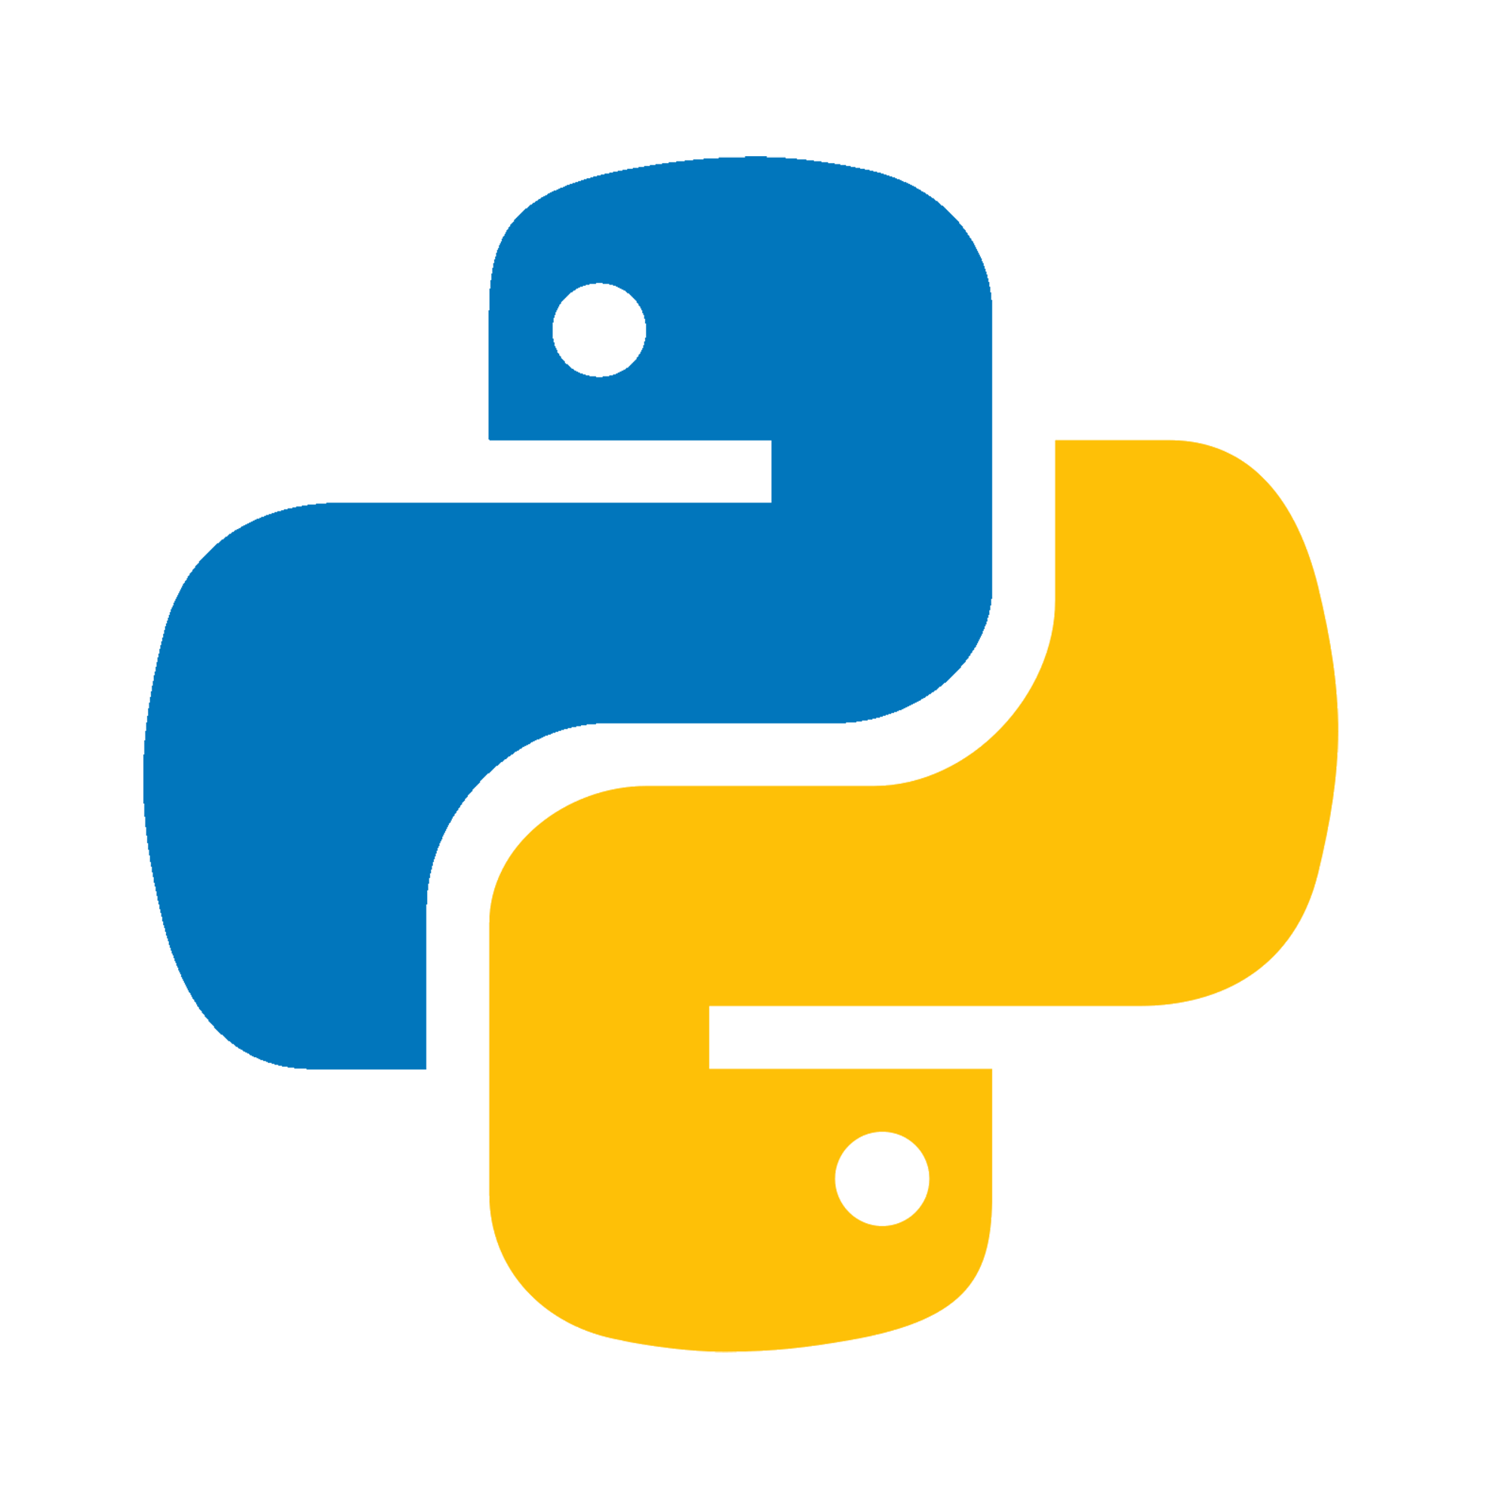
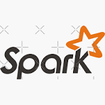
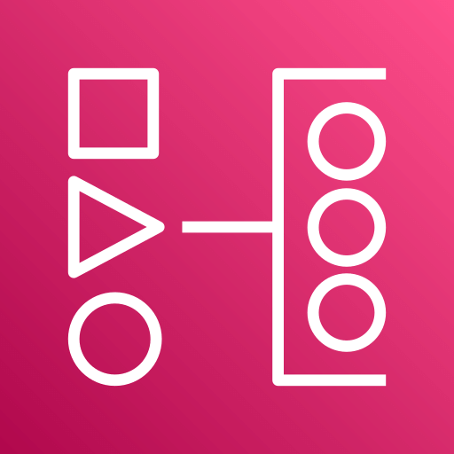
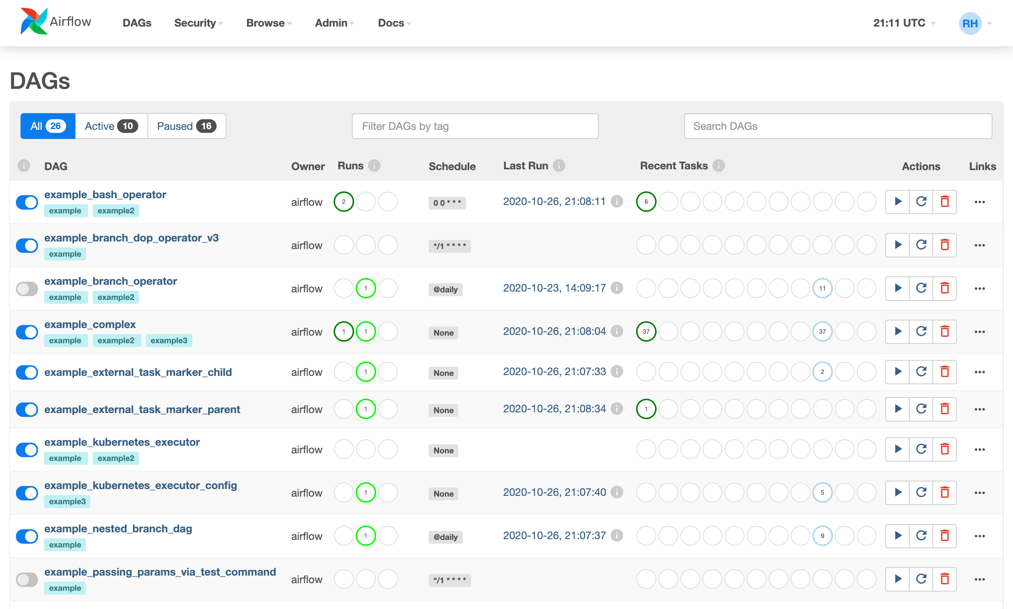
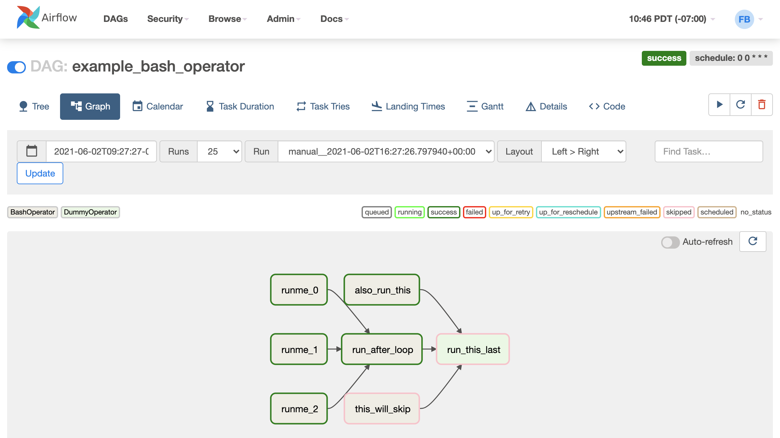
Data Product Definition: Configured, Not Coded SME-Driven. Governed by Design. Platform-Generated.
Product Definition Process
Data SMEs define Use Case Data Products
Via governed UI components
Not custom pipelines.
Select Execution Type
Lightweight synchronous (Lambda / Pandas)
Heavyweight distributed (Glue / Spark)
Policy-driven Light vs Heavy routing
Assemble Reusable Common Services
Choose standard services (DQ, filter, aggregate, enrichment)
Define execution order
Assemble Reusable Customized Services
Add custom services where required
Parameterize the Logic
Select entities and attributes
Configure transformation rules
Define service-specific parameters
No embedded code
Stores Use Case Data Product Metadata
Platform Generates Execution Package The system automatically produces:
Orchestration metadata (stored in S3 / Iceberg)
MWAA orchestration configuration
Service dependency graph
Execution plan representation
Bus Contract Automatically Detailed Generated package includes:
Output specification
Routing rules
Error handling (DLQ / retry)
Observability configuration
Service configuration overrides
Without This Model
Custom pipelines
Manual Airflow DAG creation
Inconsistent DQ
Engine-specific logic
With This Model
Declarative composition
Automated orchestration
Embedded governance
Engine-agnostic execution
Use case data product definition process
Store Orchestrion Metadata
AWS Managed
Workflows for
Apache Airflow
Light
Heavy
Finance Datamart Svc 1
...
6
7
Data Product / Pipeline Definition and Validation UI
Determine Execution Type(s)
Identify Required
Common Services
Identify Required Customized Service
Parameterize
Service Calls in Orchestration
Create Orchestration Package(s)
Deploy Orchestration
1
2
3
4
5
Transform
Aggregate
Filter
Consolidate
Collibra DQ
Audit / Logging
MDM
Ref Data Mgt
...
8
Bus Contract
MWAA Orchestration Assets
Service-side Invocation Adapters
Execution Plan Internal Representation
Output
Message Schema
Consistent Event Naming
EventBridge Rule Patterns
Step Type
Volume
DAG
service calls
dependencies
Security
LF/ABAC Tags
Data Classification
Airflow DAG Python
MWAA Dependencies
Event Consumption
Service Execution
Routing
Complexity
Volume
Runtime
Observability
Coorelation ID
Trace ID
Audit Policy
DLQ / Retry Strategy
Each Step Event
Data Product ID
Run ID / Step ID
Correlation ID
Input / Output Data References
Status / Metrics / Error Details
Airflow Config Overrides
Publish Status
Step Contract
Service name
Parameters
Retry/timeout
Idempotency key
Input/output data references
SMEs define intent. The platform generates execution.

Slide 34
Appendix 5 DLH Platform – Event Bus

Slide 35
The Event Bus as the Platform Backbone From Execution Engine to Intelligent Platform
Overview
Decouples services from orchestration
New capabilities attach without modifying pipelines
All platform intelligence becomes event-driven
Enables extensibility, governance, and AI optimization
Converts runtime execution into a scalable platform
Without the bus
Every new capability requires pipeline modification
Tight coupling between services
Hard to scale innovation
With the bus
Services listen and react independently
Capabilities are additive
Platform evolves without breaking existing workloads
This is what makes it a platform, not a framework.
Capability Summary
Core Bus-Enabled Services
Reference Data Listener
Purpose: Ensure domain consistency across all executions
Listens for data product execution events
Enriches runtime with current reference datasets
Version-aware (effective dating / domain versions)
Eliminates hard-coded joins in pipelines
Value: Centralized truth applied automatically
Transaction Log / Audit Trail Listener
Purpose: Enterprise-grade traceability
Listens to execution start/stop/failure events
Captures input shape, parameters, execution engine
Logs transformation lineage & metrics
Stores immutable execution records
Value: Auditability without burdening services
AI Listener
Purpose: Intelligent optimization & anomaly detection
Listens to execution metadata and results
Identifies optimization opportunities (light vs heavy routing)
Detects unusual data patterns or quality degradation
Feeds recommendations back into orchestration
Value: Continuous learning across the platform
Standardized execution eliminates pipeline duplication
Business logic written once; runtime selects execution context
Governance, DQ, and audit embedded by design
Event-driven extensibility enables continuous innovation
AI readiness is architectural — not aspirational
Message or Event Bus
Reference
Data Listener
Transaction Log / Audit Trail
AI Listener
Enrichment
Traceability
Learning & Routing
Decoupled. Extensible. Intelligent
How it fits together
The bus enables
Cross-cutting capabilities
Runtime intelligence
Operational visibility
Future AI augmentation
Zero coupling between concerns
The runtime runs workloads. The bus turns workloads into a learning system
Notes:
Titles:
Why the bus enables the platform
Why the Event Bus Makes It a Platform
The Event Bus: From Pipeline to Platform
Decoupled by Design: The Power of the Bus
Event-Driven Enablement: Scaling Beyond Pipelines
From Execution Engine to Intelligent Platform
The Bus as the Platform Control Plane

Slide 36
Appendix 6 DLH Platform – Execution

Slide 37
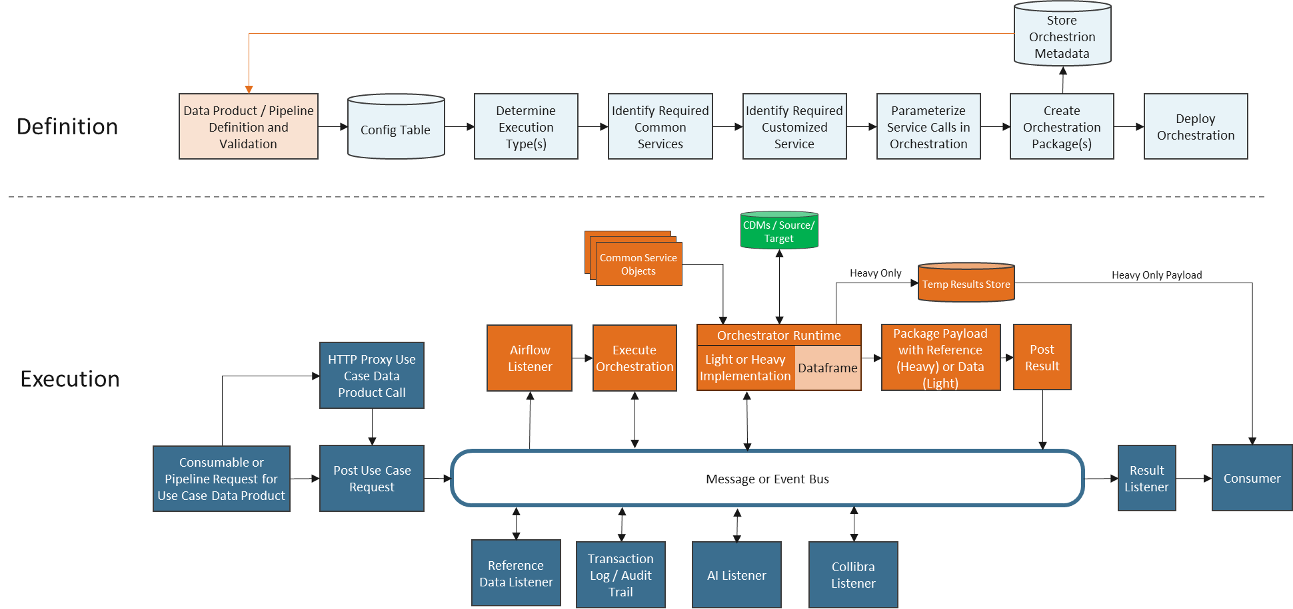
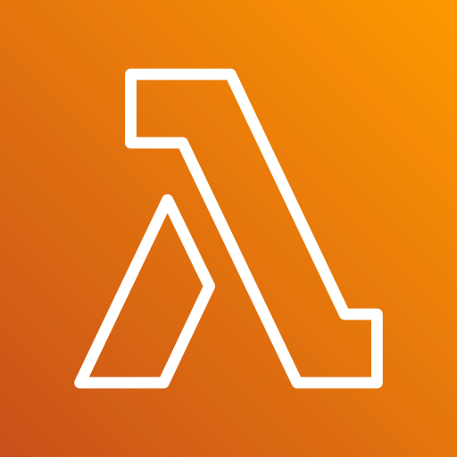
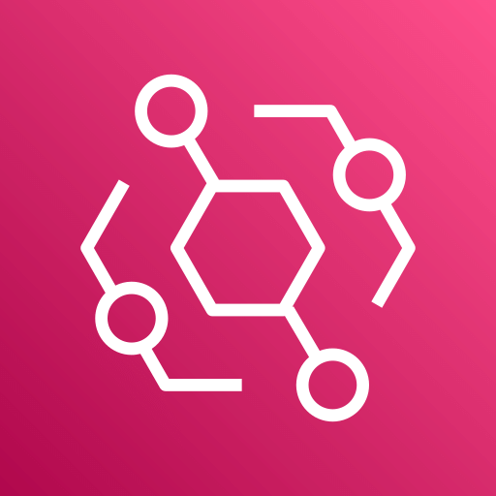
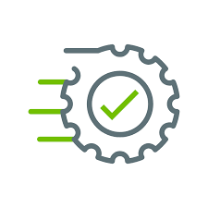
Lakehouse Conceptual Architecture Overview Architectural Benefits
Evolutionary Architecture:
Addresses robust set of Consumption Use Cases introduced in 2026 and beyond
Can be applied to Ingestion as well to support 2026 Use Cases
Addresses Concerns:
Packaged orchestration logic (pre-packaged industry-leading formats), supporting full-auditability and regression testing
Refactor existing Operators into reusable services for light and heavy execution
Multiple execution environments to optimize cost and scalability
Light and heavy paths support real-time synchronous and long-running asynchronous data requests
Existing Iceberg open data standard, stored on S3, continues to be leveraged for inbound (CDM, Nucleus bounded context, API) and outbound consumable datasets
Collibra DQ listener
Leverages rules defined in Collibra DQ
Publishes results back to Collibra, supporting enterprise data quality framework
Execution is performed by the Orchestration Runtime in memory, allowing parallel execution with specific Spark runtimes configured by dataset size.
Logging/auditing is consistent through the use of a common bus service
Reference data services, consistent through the use of a common bus service, to be leveraged by data consumers outside the Data Team.
AI capabilities, such as intelligent routing (to light or heavy implementations) leverage the same pattern as other services on the bus
AWS Eventbridge is utilized as the bus implementation for vertical scalability and enterprise observability that supports separation of orchestration from individual service definition (and implementation).
1
2
5
1
4
3
10
Rest API
8
7
9
6
Collibra DQ&O

Slide 38
Lakehouse Execution Model From Request to Data Product
Engine-Agnostic Execution: One Pattern, Any Runtime
Governed Orchestration API request triggers governed orchestration, which composes reusable services from configuration
Data Loaded Once RuntimeFrame loads data by defined shape (CDM / Datamart / Export)
Composable service implementations Transformers apply business logic once, supporting
Light – Returns result dataset
Heavy - Returns pointer to service instance ID, which will be used to:
Check status
Retrieve data via S3 URL
Supports multiple data shapes (Flat for analytics & external systems / Nested for APIs & AI)
Event Bus publishes execution events for enrichment and governance
Enables virtualized CDMs without duplicating pipelines
Supports nested and chained orchestration
Enterprise Data Quality
Integrated, not bolted on
Retrieves Parameterized DQ Rules from Collibra DQ&O
Executes in-memory within RuntimeFrame stack
Publishes results back to Collibra
Converts Collibra into a true centralized rules library
Strengths: governance + runtime enforcement
Eliminates: siloed validation layers
CDMs / Source/ Target
Common Service Objects
Heavy Only Payload
Airflow
Listener
Execute Orchestration
Orchestrator Runtime
Post Result
Light or Heavy Implementation
Dataframe
Consumable or Pipeline Request for Use Case Data Product
Message or Event Bus
Result Listener
Consumer
Reference
Data Listener
Transaction Log / Audit Trail
AI Listener
Collibra Listener

Slide 39
Engine-Agnostic Execution: One Pattern, Any Runtime
How this actually works
RuntimeFrame virtualizes execution engines (Spark, Pandas, Polars)
Services / Transformers execute functionally identical across engines
Implementation Type determines return type
Light returns dataset
Heavy returns service instance pointer
Supports flat and nested domain-aligned data shapes
Enables virtualized CDMs without duplicating pipelines
Architectural Principle:
Bring Functions to the Data
Instead of moving data between systems:
Data is loaded once per defined shape (CDM1, CDM2, Datamart1, Export123)
Logic is composed into a functional pipeline
No intermediate persistence required
No engine-specific logic in orchestration
Same pattern supports Ingress and Egress
This is what makes the architecture scalable and reusable.
Execution Pattern (How it actually works)
Service produces a Transformer Each service validates config and emits a pure transformation function. FilterService(spec).fn() → Transformer
Transformers are composed A pipeline is constructed from reusable, engine-agnostic logic. pipeline = compose(FilterService(...).fn(), CollibraDQService(...).fn(), AggregateService(...).fn())
Pipeline executes against a RuntimeFrame Execution engine is abstracted. Same code runs on Spark (heavy) or Pandas (light). result = pipeline(runtime_frame)
Core Architectural Components
RuntimeFrame
Wraps Spark or Pandas in-memory DataFrame
Provides consistent execution contract
Encapsulates data “shape” (Flat or Nested)
Transformer
DataFrame in → logic applied → DataFrame out
Stateless, composable, chainable
Engine-agnostic
Service Base
Abstract service that:
Validates configuration
Handles logging and telemetry
Routes to correct light/heavy implementation
Wraps execution with consistent error handling
Produces a Transformer
Concrete Services
Contain only engine-specific dataframe operations
No orchestration logic
No cross-cutting concerns
Service produces a Transformer FilterService(spec).fn() → Transformer
Transformers are chained pipeline = compose( FilterService(...).fn(), CollibraDQService(...).fn(), AggregateService(...).fn())
Pipeline executes against a RuntimeFrame result = pipeline(runtime_frame)
RuntimeFrame
Engine: Spark | Pandas | Polars
Shape: Flat | Nested
Adapter Layer:
AdapterSpark / AdapterPandas / AdapterPolars
Reads Data
FilterTransformer
(Predicate Pushdown / Nested Filtering)
Common Service Objects
DQTransformer
(Rules, Explode→Validate→Re-Nest, Audit)
CDMs / Source/ Target
AggregateTransformer
(Group / Rollup / Nested Aggregation)
Writes Data
FinalRuntimeFrame
Flat Output: BI / SQL / Analytics
Nested Output: API / Event / AI Payloads
Audit & Lineage: Status / Counts / DQ Results
Orchestrator Runtime
Light or Heavy Implementation
Runtime Dataframe
Message or Event Bus
Collibra Listener
Write business logic once. Runtime decides how and where it executes.
Notes:
Alternative titles:
The Functional Execution Model Behind the DLH
Engine-Agnostic Execution: One Pattern, Any Runtime
Composable Data Products: How the Runtime Works
Bring Functions to the Data: The Execution Architecture
Virtualized CDMs Through Functional Composition
A Unified Execution Model for Light & Heavy Workloads
One Pipeline. Any Engine. Any Shape.

Slide 40
Engine-Agnostic Execution: Service + Transformer Pattern
How this actually works
RuntimeFrame virtualizes execution engines (Spark, Pandas, Polars)
Services / Transformers execute functionally identical across engines
Implementation Type determines return type
Light returns dataset
Heavy returns service instance pointer
Supports flat and nested domain-aligned data shapes
Enables virtualized CDMs without duplicating pipelines
Architectural Principle:
Bring Functions to the Data
Instead of moving data between systems:
Data is loaded once per defined shape (CDM1, CDM2, Datamart1, Export123)
Logic is composed into a functional pipeline
No intermediate persistence required
No engine-specific logic in orchestration
Same pattern supports Ingress and Egress
This is what makes the architecture scalable and reusable.
Execution Pattern (How it actually works)
Service produces a Transformer Each service validates config and emits a pure transformation function. FilterService(spec).fn() → Transformer
Transformers are composed A pipeline is constructed from reusable, engine-agnostic logic. pipeline = compose(FilterService(...).fn(), CollibraDQService(...).fn(), AggregateService(...).fn())
Pipeline executes against a RuntimeFrame Execution engine is abstracted. Same code runs on Spark (heavy) or Pandas (light). result = pipeline(runtime_frame)
RuntimeFrame
Engine: Spark | Pandas | Polars
Shape: Flat | Nested
Adapter Layer:
AdapterSpark / AdapterPandas / AdapterPolars
Core Architectural Components
RuntimeFrame
Wraps Spark or Pandas in-memory dataframe
Provides consistent execution contract
Encapsulates data “shape” (Flat or Nested)
Transformer
DataFrame in → logic applied → DataFrame out
Stateless, composable, chainable
Engine-agnostic
Service Base
Abstract service that:
Validates configuration
Handles logging and telemetry
Routes to correct light/heavy implementation
Wraps execution with consistent error handling
Produces a Transformer
Concrete Services
Contain only engine-specific dataframe operations
No orchestration logic
No cross-cutting concerns
Service produces a Transformer FilterService(spec).fn() → Transformer
Transformers are chained pipeline = compose( FilterService(...).fn(), CollibraDQService(...).fn(), AggregateService(...).fn())
Pipeline executes against a RuntimeFrame result = pipeline(runtime_frame)
Pseudo Code
# Select execution context
runtime = RuntimeFrame.initialize(
data_shape="CDM1",
execution_mode="heavy", # light | heavy
engine="spark“
)
# Declare transformation pipeline (engine-agnostic)
pipeline = DataPipeline.compose(
FilterService(spec=filter_spec),
CollibraDQService(spec=dq_spec),
AggregateService(spec=agg_spec)
)
# Execute functional pipeline against runtime
result = pipeline.execute(runtime)
# Persist or emit results
result.publish(target=output_target)
Reads Data
FilterTransformer
(Predicate Pushdown / Nested Filtering)
Common Service Objects
DQTransformer
(Rules, Explode→Validate→Re-Nest, Audit)
CDMs / Source/ Target
AggregateTransformer
(Group / Rollup / Nested Aggregation)
Writes Data
FinalRuntimeFrame
Flat Output: BI / SQL / Analytics
Nested Output: API / Event / AI Payloads
Audit & Lineage: Status / Counts / DQ Results
Orchestrator Runtime
Light or Heavy Implementation
Runtime Dataframe
Message or Event Bus
Enterprise Data Quality
Integrated, not bolted on
Retrieves Parameterized DQ Rules from Collibra DQ&O
Executes in-memory within RuntimeFrame stack
Publishes results back to Collibra
Converts Collibra into a true centralized rules library
Strengths: governance + runtime enforcement
Eliminates: siloed validation layers
Collibra Listener
Write business logic once. Runtime decides how and where it executes
Notes:
Alternative titles:
The Functional Execution Model Behind the DLH
Engine-Agnostic Execution: One Pattern, Any Runtime
Composable Data Products: How the Runtime Works
Bring Functions to the Data: The Execution Architecture
Virtualized CDMs Through Functional Composition
A Unified Execution Model for Light & Heavy Workloads
One Pipeline. Any Engine. Any Shape.

Slide 41
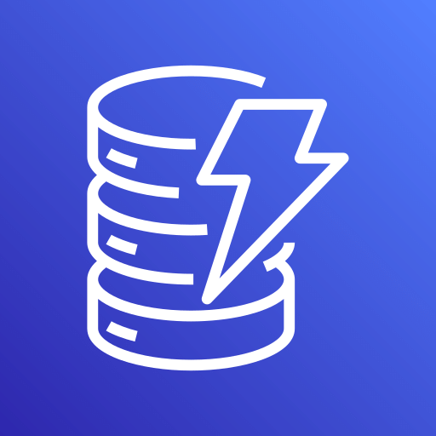
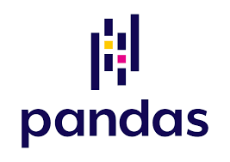



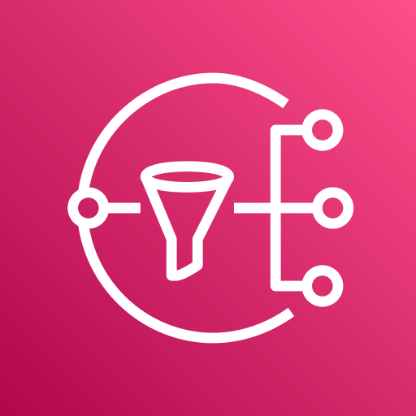
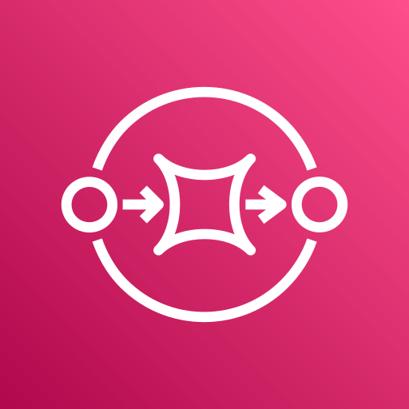

Lakehouse Conceptual Architecture Overview Detailed Consumption Flow
Process Flow:
Data Consumer requests Data from Router (Eventbridge)
The Router triggers an Orchestration function
The trigger activates the Orchestrator with configuration in the service envelope
Orchestrator produces a services DAG (ordered list of services)
Orchestrator publishes message on Consumption Event Bus 5b. Route Optimization Service listens for data product requests from 5, executes AI workflows on Bedrock and publishes any recommended optimized optimizations back to the bus
Data Product Service X receives message to instantiate based on the message configuration from 5
Data Product Service X retrieves list of services, constructed by Orchestrator
A service registry allows required services to be located and returned.
The message configuration will define whether the implementation type is Light or Heavy
If the configuration includes Collibra DQ, a message is sent to the bus, where a list of DQ rules bound to the configured dataset is returned by the Collibra DQ services via a restful API call to the Collibra DQ&O instance (once the rules are executed by each Data Product Service, the results will be forwarded to DQ&O vis the bus).
Any data required is retrieved from S3 and/or Athena Iceberg tables and loaded into memory (by implementation type) by the Data Product Service. Each of the configured services are executed on the in-memory data. After all of the services are complete, the payload is either saved to S3/Athena Iceberg tables (heavy) or packaged up in the status response message, which is published to the bus. As each service completes, updated event status are published to the bus
Data Product Service publishes technical details to CloudWatch logs
An orchestration feedback queue subscribes to the bus which is configured to forward to the Router (from 1), which is then stored to a persistent store
Business auditable events (published to the bus by each Data Product Service) are published to Audit Log
Any heavy requests are forwarded back to data consumer by a Consumption Response Service
Event State
Services DAG
Common / Custom Services
Implementation Type
Data Reading / Writing
Service
Library
Service
Registry
Light
Heavy
S3 Data
SQL
9
11
8
Data Product 1
Service
13
4
7
Technical Logs
1
2
3
5
6
12
Data
Consumer
Router
Trigger
Orchestration
Orchestrator
Consumption
Event Bus
5b
13
Orchestrator
Feedback
Queue
Audit
Service
Collibra DQ
Service
10
Route Optimization
Service
15
14
Rest API
5b
Consumption Response
Service
DAG
Optimization
Model
Audit Log
Collibra DQ&O

Slide 42
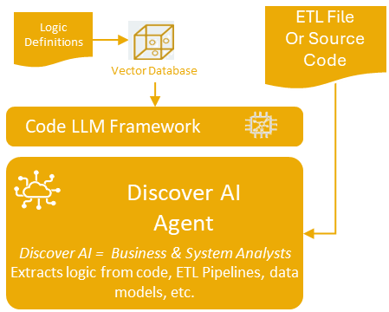

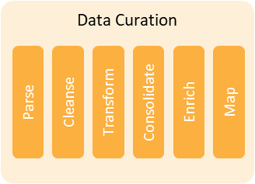

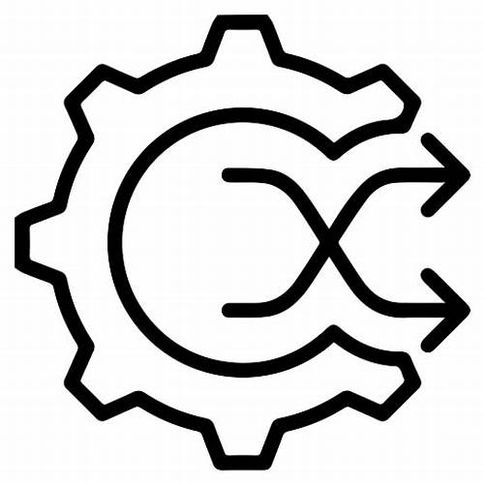
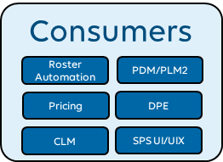

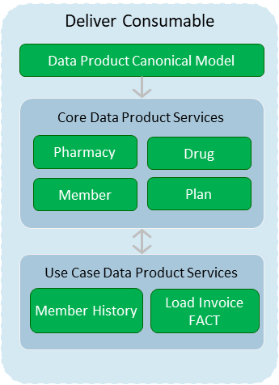


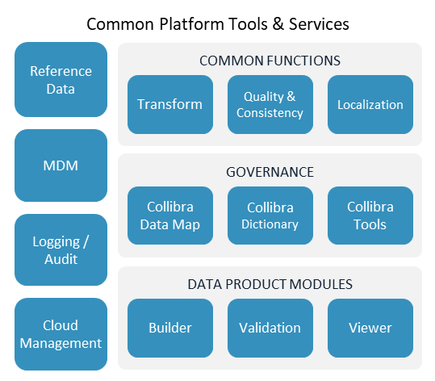



Code Review
Consumables
DLH Data Platform
Ingest
Raw
Code LLM Framework
Native
ODS
Developer AI Agent
Technology AI = Data Engineer
Generates python code
Code Module Change Control
CDMs
BI & Analytics
Request
Core Data Product Services
Datamarts
Deploy Code
Order
Shipment
Invoice
Customer
Data Governance Board
Data Product Owner
Curated Data Sets
Use Case Data Product Services
Feedback to Data Product Owner and AI
Stewardship AI Agent
Stewardship AI = Data Steward
Ensures business consistency of Data
Customer History
Load Product Dim
Data
Data
Data
Data Product Failure feedback loop for AI Resolution
AI
RAG/Vector DB
Multi-Agent Framework
Allows For CDM training
Conflict Resolution
Transactional
API Gateway
Commander
Data Product Baselines
Agent 1
Agent 2..n
Automated Testing and Validation
Immutable Facts
RAG
Baseline Agent
Developers & Code GenAI
Data Steward & Stewardship LLM AI
Feedback Loop

Slide 43
How Do We Do This in a Modern Data Architecture?
Modern enterprises do not scale by moving data faster. They scale by standardizing how data is delivered and consumed.
The shift is simple:
Stop delivering datasets.
Start delivering Data Products.
A Data Product is not a file, extract, or pipeline — It is a governed, versioned, accountable interface to trusted data.
Architectural Interpretation
Treating data as a product requires:
Config-driven composition instead of custom pipelines
Reusable transformation and governance services
Engine-agnostic execution
Embedded lineage, observability, and policy controls
Event-driven extensibility
This moves us:
From → Ad-hoc consumption To → Standardized, governed product delivery
Why the Business Thinks in Products | What the Architecture Must Deliver
Defined purpose and outcome | Authoritative CDM-aligned interface
Clear ownership | Named Data Product owner
Stable contract | Versioned schema & contract
Quality expectations | Embedded DQ & SLA enforcement
Predictable delivery | Governed orchestration & routing
Controlled evolution | Schema stability with versioning
Product thinking transforms data consumption from an activity into an enterprise capability.

